Slide 1
COVID-19 Data Visualization and Analysis using Python
Aakash Bhagat

Slide 2
Purpose of the project
The purpose of this project is to track and report the daily progress of deaths, variation of the positive and negative cases per states, most affected states, least affected states, variation in the number of people hospitalized and are currently in ICU.

Slide 3
About the Data
The data from the COVID tracking project website is pulled using two APIs, i.e. one for the state data and other for the US current
https://covidtracking.com/api/v1/us/daily.json https://covidtracking.com/api/v1/states/current.json

Slide 4
Workflow
COVID Tracking Project API
JSON / CSV Files Generated
Data Exploration
State and US latest stats displayed as output
Visualization and Reporting of State and US Data

Slide 5
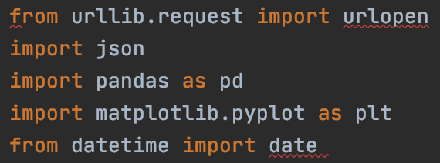
Libraries Used

Slide 6
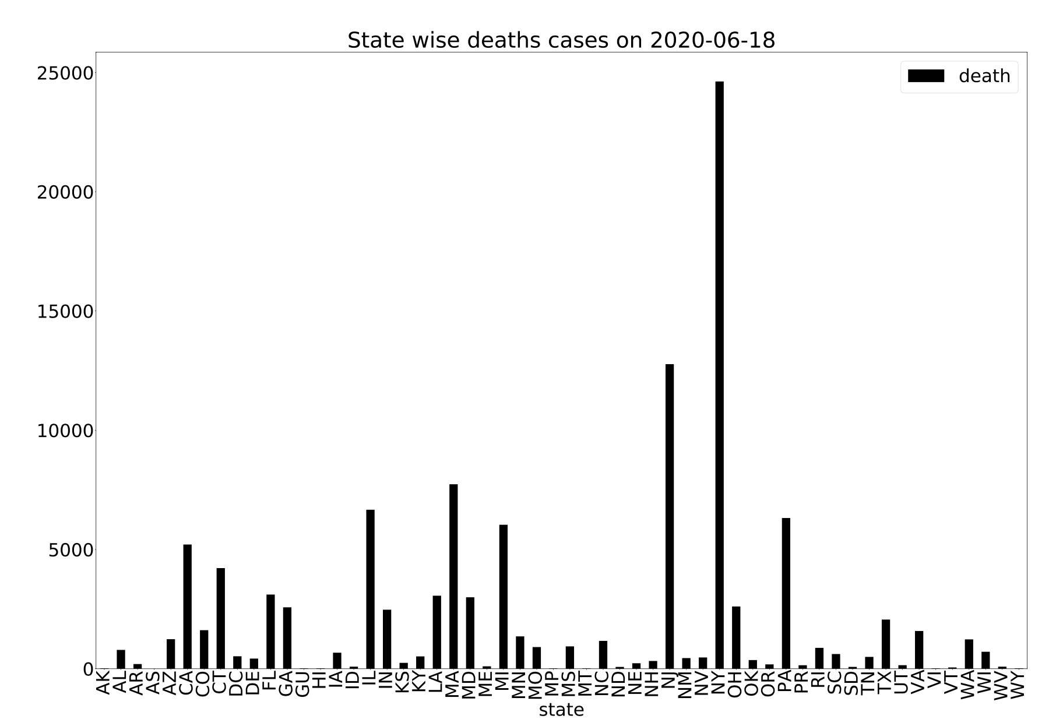
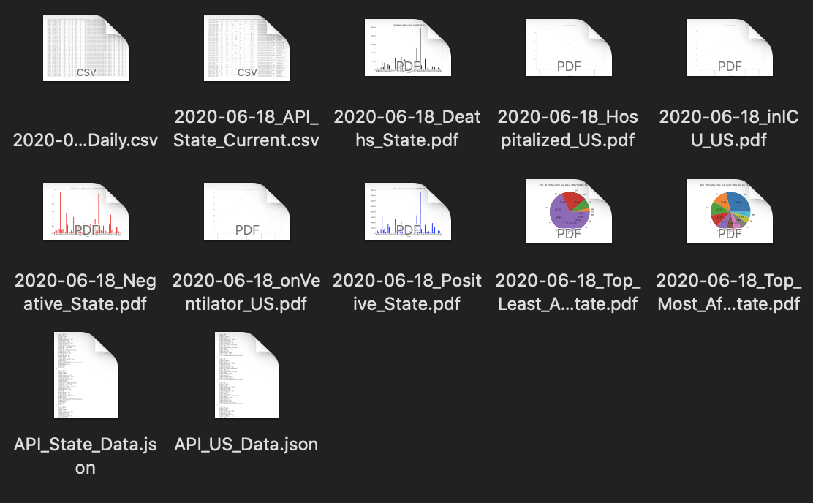
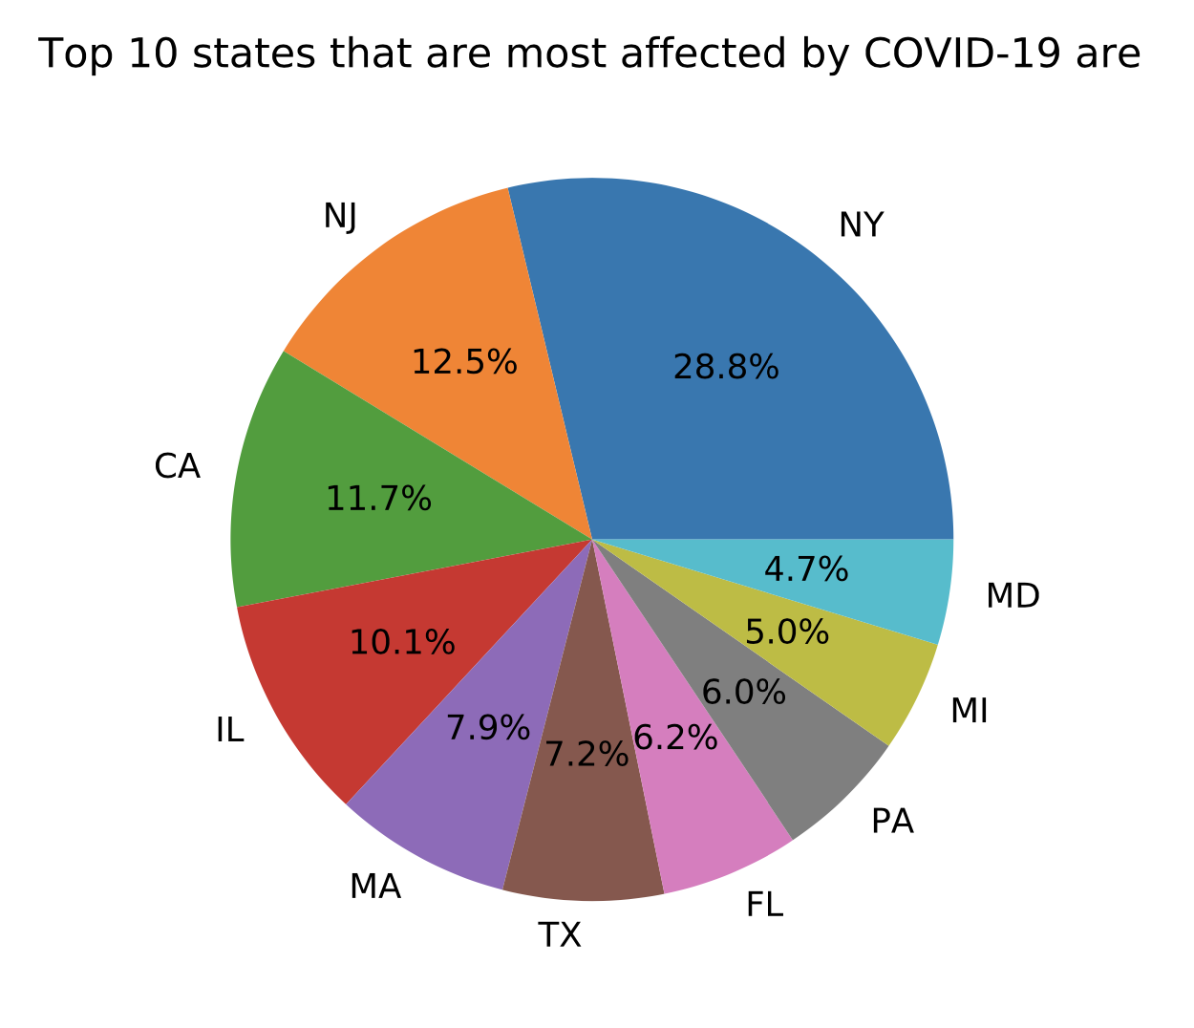
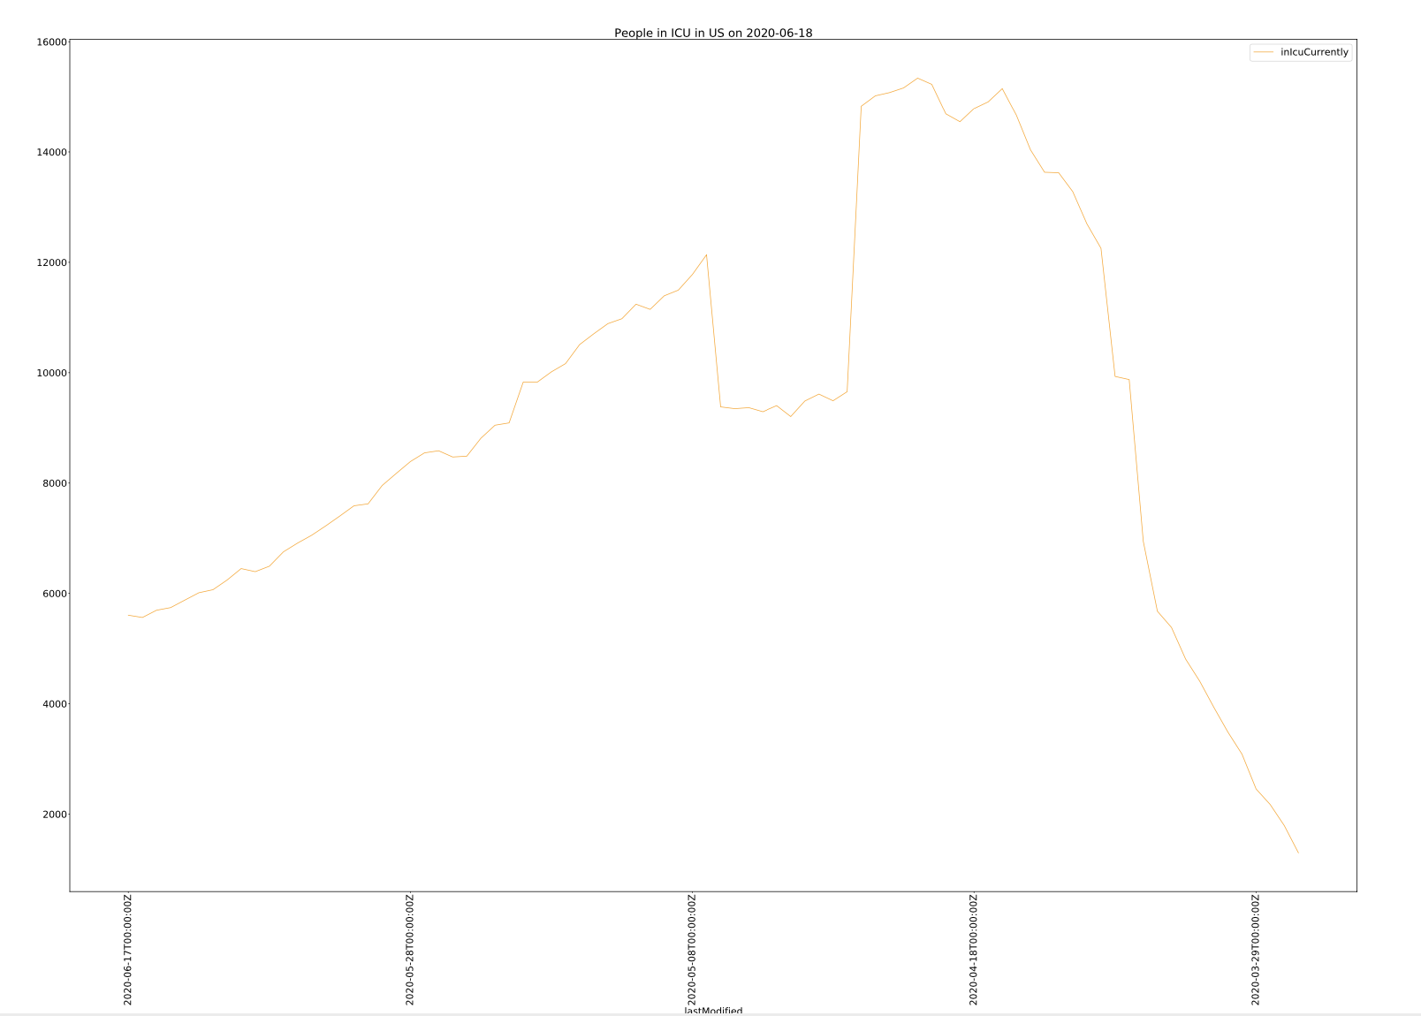
Output

Slide 7
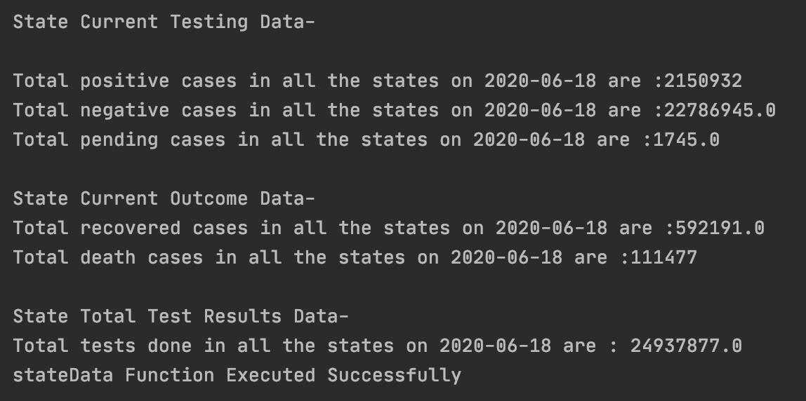
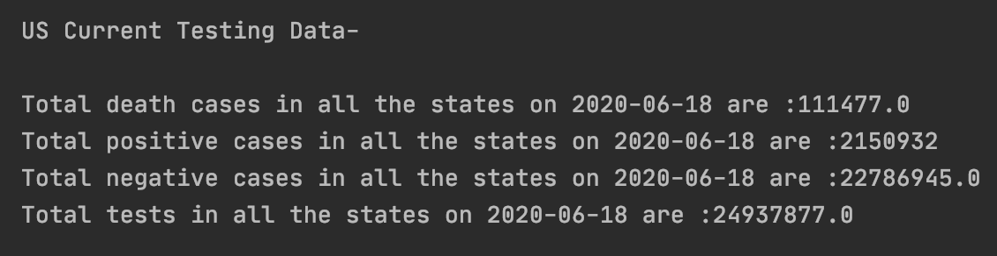
Output

Slide 8
Conclusion
From the current analysis of the visualizations we can conclude that:
The top 5 most affected states are: NY, NJ , CA, IL, MA
The top 5 least affected states are
The number of patients admitted into hospitals is increasing
The number of patients in ICU is declining

